Slide 1
EXPLORATORY DATA ANALYSIS OF COVID-19 DATA IN UNITED STATES
TANISHQ CHERUKURI

Slide 2
Introduction
The aim was to perform an EDA on Covid-19 data collected in the United States from the period July 2020 to July 2022, Compressed the data to 5000 rows and 8 columns.
The goal was to get an in-depth understanding of the effects of Covid-19 on the lives of the people living the United states.
The data was collected on Kaggle and transferred to Jupyter Notebook for analysis .
The results are as seen in the slides below.

Slide 3
Summary of vital statistics
The results above are a summation of some of the vital statistics in regard to Covid .
Where the total number of cases and deaths in addition to the mortality rate were all produced.
Based on the total number of confirmed deaths , the mortality rate during the period was 1.54 meaning that the confirmed cases have a times 1.54 chance of dying from Covid.
Total Cases | Deaths | Total Confirmed Cases | Total Confirmed death | Mortality rate %
19580497292 | 291026110 | 16678183421.0 | 257372973.0 | 1.540

Slide 4
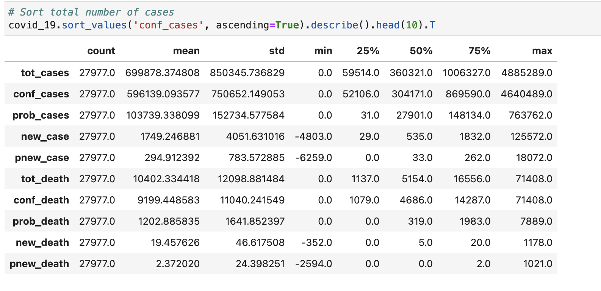
Descriptive statistics
The results represent the descriptive statistics of various Covid vital statistics For instance , the mean number of covid-19 cases for the mentioned period was 699878.34 which is quite significant. In comparison the mean number of deaths was 10402.334 .

Slide 5
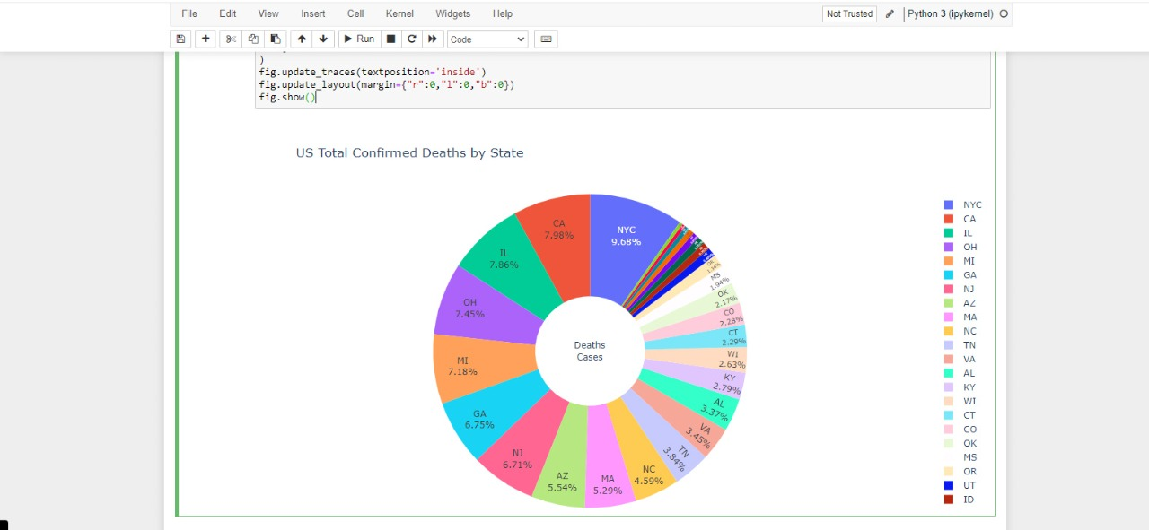
Confirmed deaths by state
Looking at the chart above the state with the highest confirmed death cases was New York city , with a confirmed death cases of 9.98% followed closely by California
Notes:
.

Slide 6
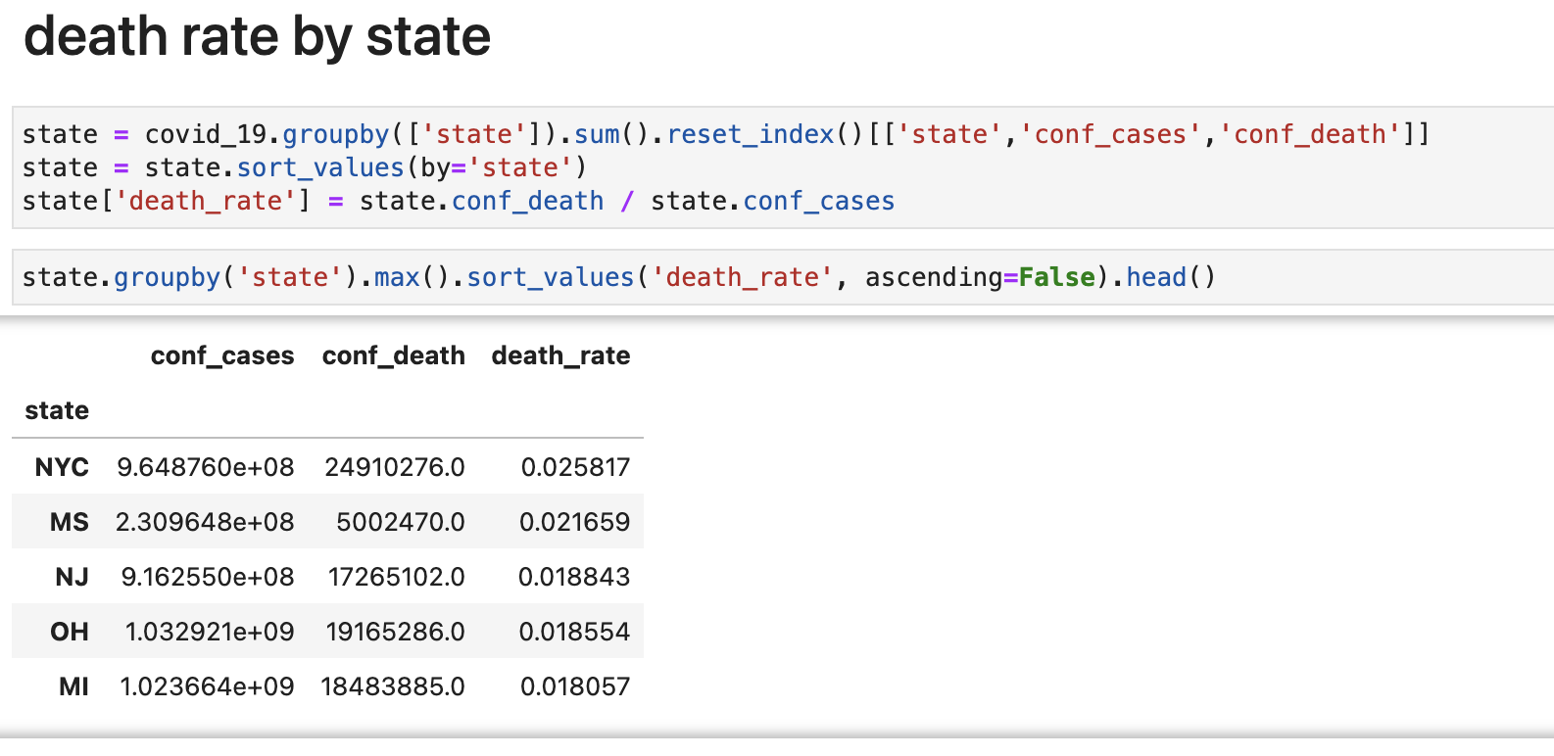
Death rate by state
The table above was used to complement the results of the previous chart on the confirmed number of deaths by state.
For this particular analysis , the number of deaths were tabulated as per the death rate which is the ration between the number of confirmed cases and the number of deaths .The results showed that New York City had the highest death rate followed closely by Mississippi.

Slide 7
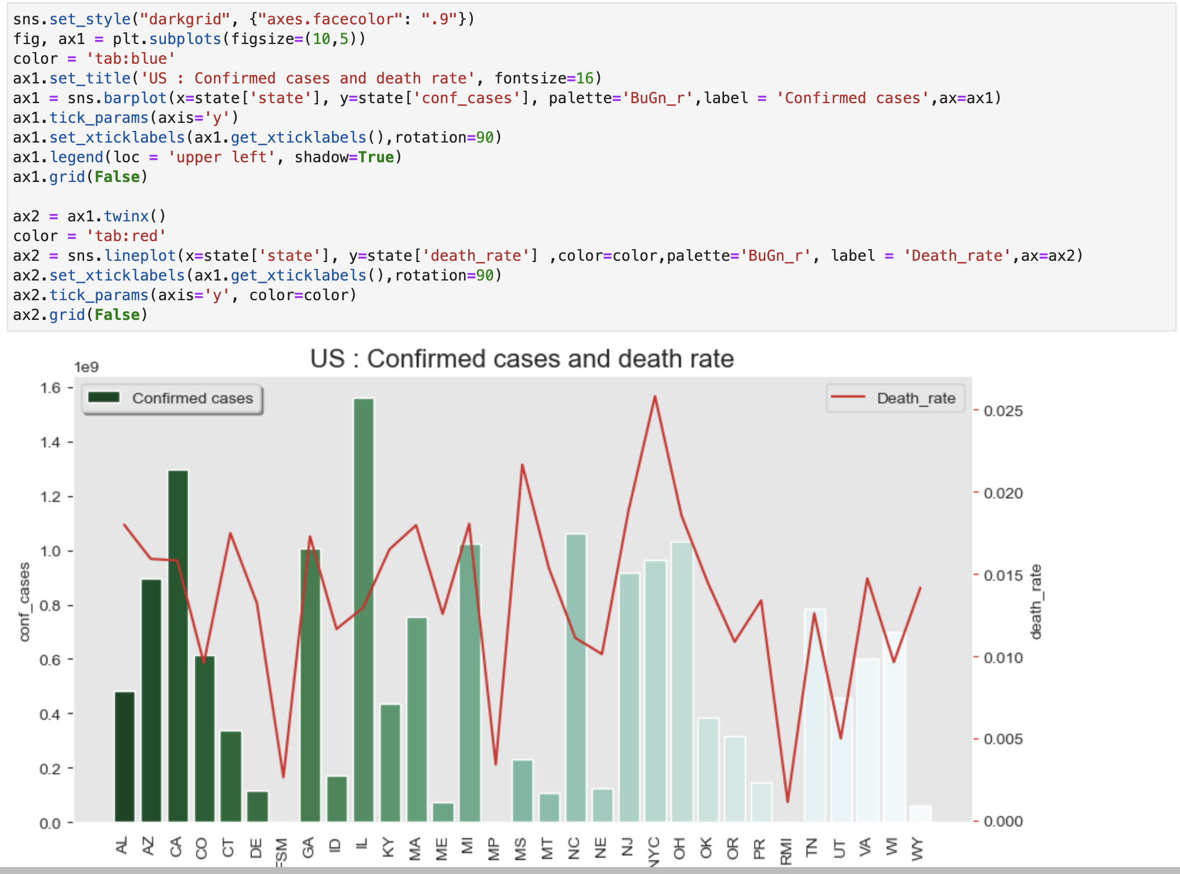
Confirmed cases and death rate by state
As per the graph Illinois had the highest number of confirmed cases , and a death rate of above 0.015 While New York City had the highest death rate of 0.025 and over 1 million total number of confirmed cases.

Slide 8
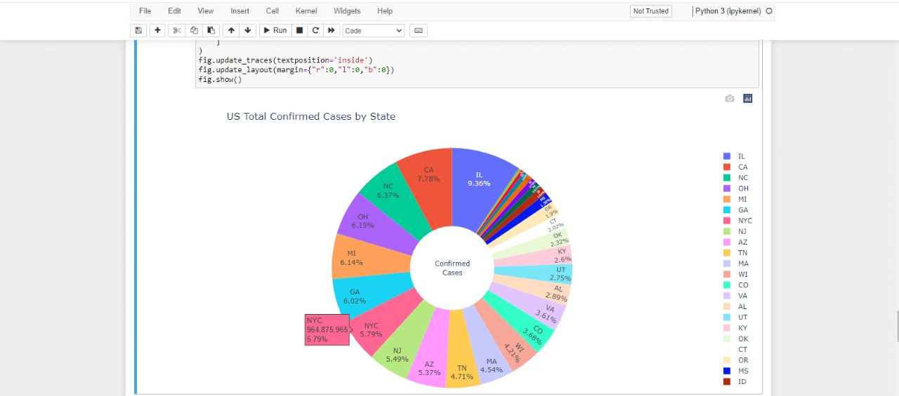
Total confirmed cases by state
Looking at the chart above the state with the highest total number of confirmed cases was Illinois , which accounted for 9.36% of the total confirmed cases followed closely by California and New York City.

Slide 9
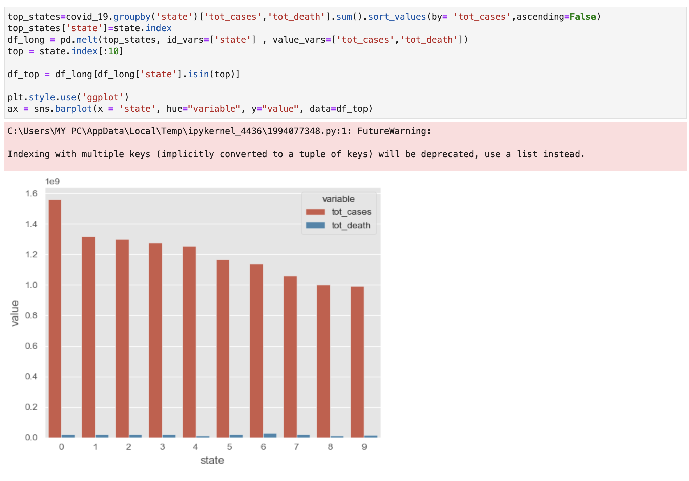
Bar graph of total confirmed cases per state
The information on the bar graph is similar to that on the chart , where the highest number of cases recorded per state was in Illinois followed by California and New York City.

Slide 10
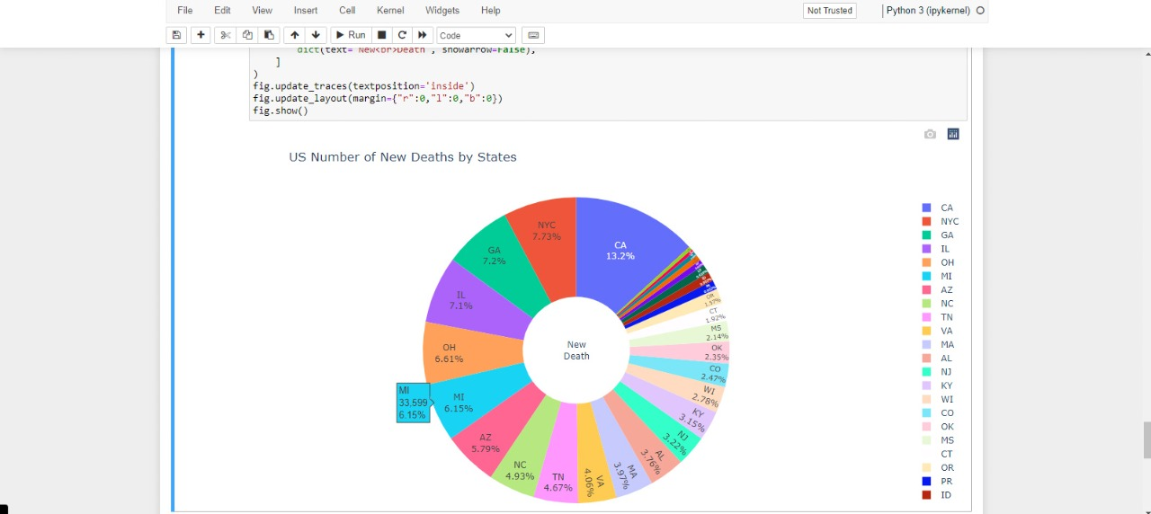
Number of new deaths by state
The chart above shows the number of new deaths by state. From the chart , California had the highest number of new deaths followed by New York City.

Slide 11
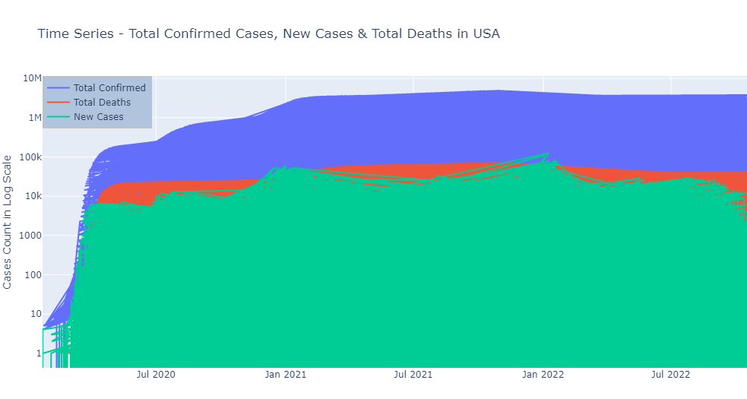
Trend of confirmed cases , deaths and new cases.
The graph above is a time series plot showing the trend of total confirmed cases , total deaths and new cases. The trend shows there was an increase in said entities . But as from 2022 the number of new cases started decreasing gradually.

Slide 12
Conclusion
The aim of this paper was to perform an EDA on various vital statistics in regards to the effects of Covid-19 on the US population for the period 2020 to 2021. The results of the analysis showed that the country was greatly impacted by the virus and state wise New York City, Illinois, California and Georgia were some of the states that were greatly impacted by the virus. The reason could be tied to the fact that the said states are densely populated. Additionally, it could be due to the fact that each state had its own Covid-19 policies that were somewhat in tandem with ones implemented by the national government with a slight variation. But the effects of the virus were only significant in the first year .2020 was a bad year for the country in regard to the virus , but the implemented government polices and the WHO regulations reduced the rise of the virus and by early 2021 there was a decrease in the total number of newly recorded cases.

